Slide 1
Image Processing - Handy Pandies
Authors: Peter Kinsella C16338263, Stephen Sheridan C16746195, Su Ye Shan Daniel D16122889

Slide 2
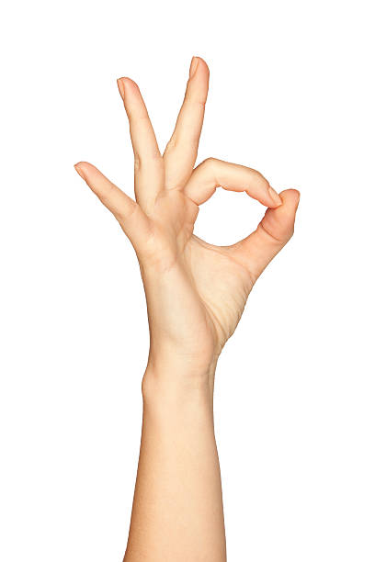

Objective
Our main objective was to be able to locate someone doing the OK hand sign in an image

Slide 3
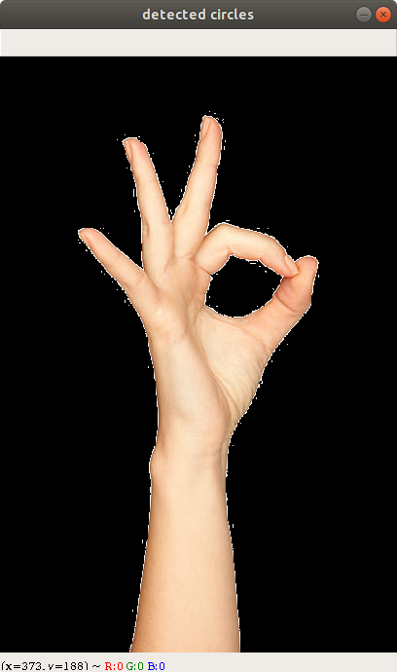
Flesh Detection
gray = cv2.cvtColor(resized, cv2.COLOR_BGR2GRAY)
blur = cv2.GaussianBlur(gray, (5, 5), 0)
ret, thresh = cv2.threshold(blur, 70, 255, cv2.THRESH_BINARY_INV + cv2.THRESH_OTSU)
boundary = cv2.morphologyEx(thresh, cv2.MORPH_GRADIENT, shape)

Slide 4
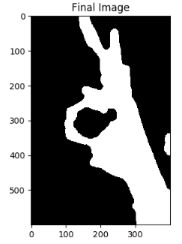
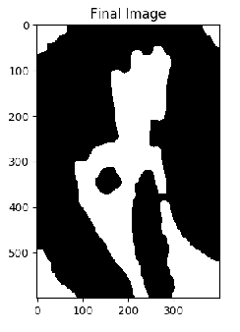
Threshold

Slide 5
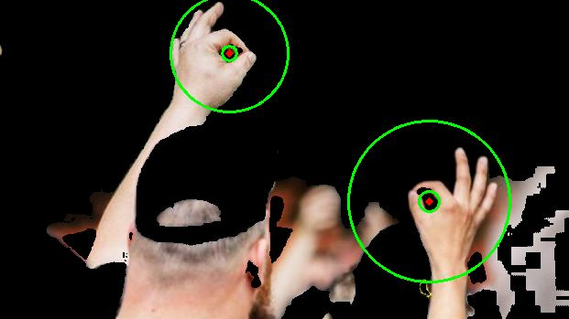
Hough circles and skin detection

Slide 6
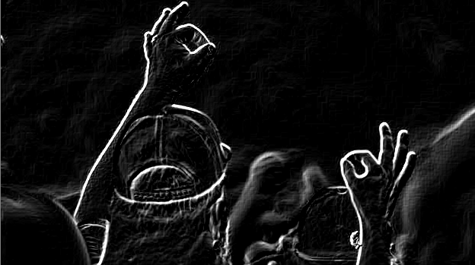
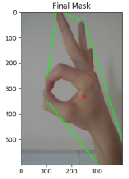
Find Contours

Slide 7
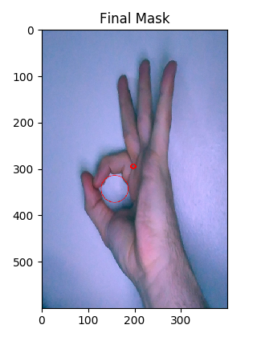
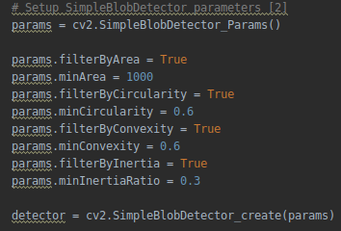
Blob detection

Slide 8
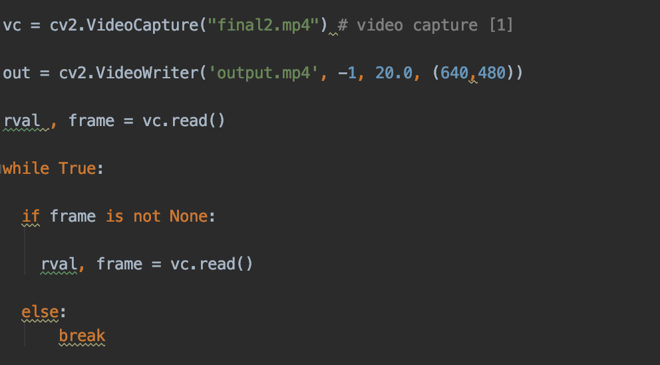
Moving on to moving images

Slide 9
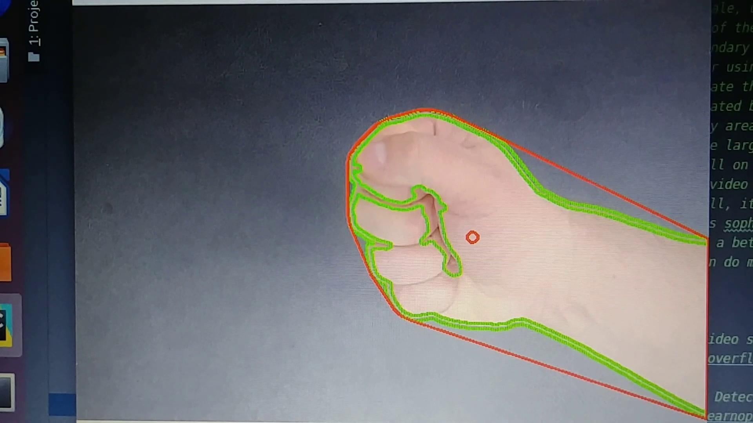
Result

